Slide 1
Building Your Team to Last: Successful Onboarding and Mentoring Practices
Sarah Withee
@geekygirlsarah

Slide 2
Building Your Team to Last: Successful Onboarding and Mentoring Practices
Introduction
Misconceptions about junior devs
Benefits for junior developers/interns
Benefits for senior developers
What does an effective (healthy) relationship look like?
Ensuring you’re ready for new juniors
Conclusion
Notes:
Abstract
Junior developers are often billed as The Answer to the talent shortage in tech and the chronic homogeneity of the tech industry. Hiring a junior developer, however, is the start and not the end of this process.
This talk will cover onboarding and mentoring junior developers successfully. We’ll discuss the benefits of bringing junior developers onto an established team. We’ll also show how senior AND junior developers can benefit by working together during the onboarding process. Some patterns of ineffective mentoring and why they are harmful to the team will be discussed. By the end, you’ll see how your whole team will ultimately benefit from these mentoring strategies.

Slide 3
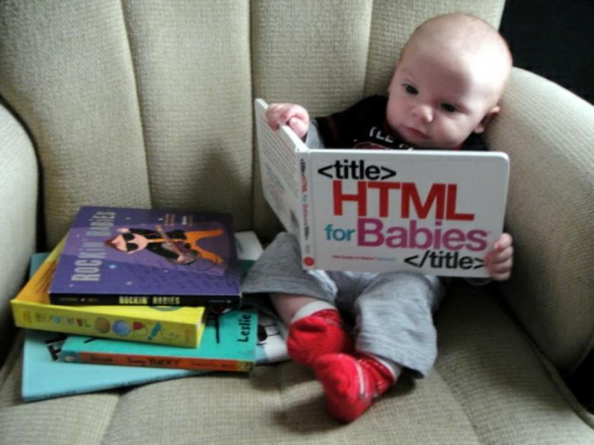
Intro
Based on my own experiences, as well as conversations with a dozen other junior and senior developers or designers
“juniors” – fresh graduates of universities, code schools, bootcamps, or self-taught devs with < 2 years experience
“seniors” – people with many years of experience and often lead teams.
For this talk, “mid” level people are seniors too
This is written mostly from a developer perspective, but can work for any job position/team (designers, QA, tech writers, etc.)
Notes:
Foreword
a. Experiences are my own, as well as conversations with junior and senior devs
b. Juniors are referring to fresh graduates of universities, code schools, bootcamps, or self taught devs with usually less than 2 years experience
c. Seniors are referring to people with many years of experience and usually
lead developers, architects, or other positions. For the purposes of this talk, could
include mid-level devs too
d. While written aimed at developers, it could really apply to any job group (designers, QA, tech writers, etc.)

Slide 4
My Background
Loved programming as a kid on my Comodore 64
Went to college, dropped out, went back to complete it (2011-2015)
Started teaching C++ lab in 2012
Internship 1 in 2013
Internship 2 in 2014 (same company, different team)
Started teaching C++ lecture in 2014
“Real World Job” in 2015 after graduation
Onboarding program with job was three-month internal project and 3 five-month rotations
Total onboarding experiences: 8
Notes:
Foreword
a. Experiences are my own, as well as conversations with junior and senior devs
b. Juniors are referring to fresh graduates of universities, code schools, bootcamps, or self taught devs with usually less than 2 years experience
c. Seniors are referring to people with many years of experience and usually
lead developers, architects, or other positions. For the purposes of this talk, could
include mid-level devs too
d. While written aimed at developers, it could really apply to any job group (designers, QA, tech writers, etc.)

Slide 5
Misconceptions about junior devs
Junior devs are effective mind-readers
Junior devs understand exactly what’s expected of their code as soon as they walk in the door
Juniors understand the nature of working on production code in a team
Juniors will get it right on the first try
Juniors are 20-year-olds fresh out of college/internships
Junior developers all have the same knowledge out of their education
Notes:
Misconceptions about junior devs
a. Junior devs are effective mindreaders
i. [Sarah] First task was to fix a bug on an installer I hadn’t ever seen for a product I had never heard of using Kanban (of which I hadn’t used Agile anything before)
b. Junior devs understand exactly what’s expected of their code as soon as they walk in the door
i. They aren’t taught production code in team environments in school
ii. Good practices aren’t taught often. If they are, it’s usually pretty quick
iii. [S]
c. Juniors understand the nature of working on production code in a team
i. This is often not taught in schools and is a complex part of effective engineering
ii. Often have worked with small class projects, not large ones
iii.
d. Juniors will get it right on the first try
i. They likely may not, but it’s ok, good learning practice
ii. Doesn’t development end up trying a hundred things until one thing works anyway?
e. Juniors are 20-year-olds fresh out of college/internships
i. It can be frustrating to find that companies only bring in people via internships
ii. Or that they all imagine juniors to be completely unfamiliar with working.
iii. Or that they’re all super young
iv.[Sarah] “Intern games”
f. Junior developers all have the same knowledge out of their education
i. Bootcamps, computer science degrees, IT degrees, books, workshops ...definitely not all built the same

Slide 6
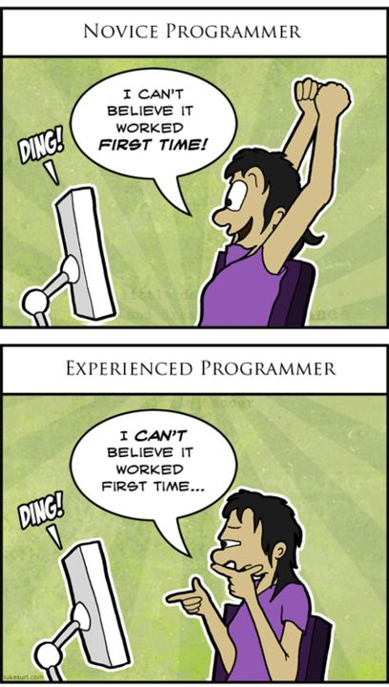
Paraphrased
Lack of experience != Lack of ability
Being new != Being stupid

Slide 7
Benefits for junior developers/interns
Growth
Put energy to good use
Discovering interests
Build good relationships with seniors (or anyone with more experience)
Cheaper/easier to hire
Get involved in workplace and community
Notes:
Benefits for junior developers/interns
(5-7 things)
a.(Probably don’t think a lot about I have a new developer, what are they going to get out of this? How are they going to grow? )
b. Put energy to good use
i. They ’re excited to work there. Being shown the ropes and how things work will make them happier to get started and less daunted/scared
c.
d. How does this apply to interns?
e. How does this apply to senior/senior dev relationships? (Senior may be exposed to new/better technologies or a new approach to a solution
f. Cheaper/easier to hire

Slide 8
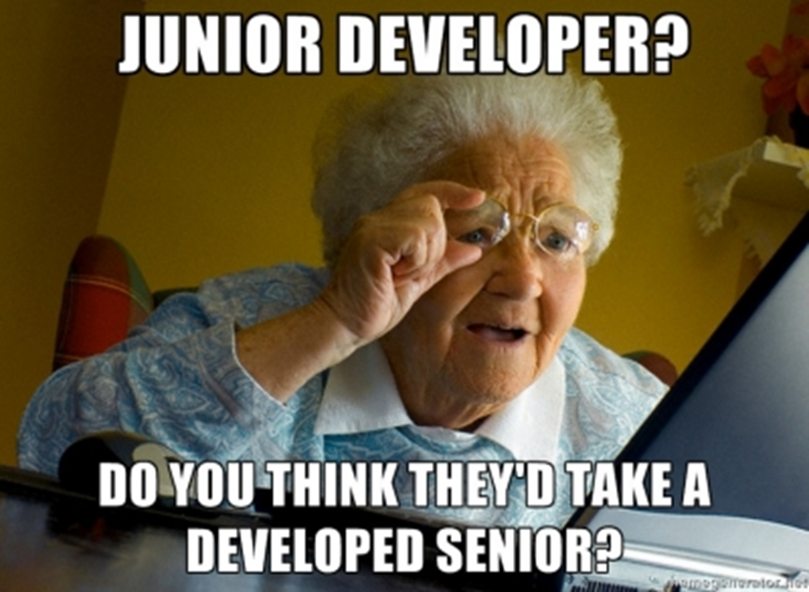

Slide 9
Benefits for senior developers
Time away from regular work
Reevaluating how you do things
More time spent in the beginning saves you MORE time down the road
See new ideas
Break out of homogeneity
Investing in the future of your team
Get more side work done
Notes:
a. Time away from regular work
i. Admit it: you don’t always want to be stuck fighting fires all the time
b. Reevaluating how you do things
i. Getting asked questions about your work means you have to explain it. If you have good explanations, you’re probably doing fine. If you don’t...maybe time to look at how you do things
ii. Helps eliminate invisible expectations that are in the system
iii.
c. More time spent in the beginning saves you MORE time down the road
i. If they know what they’re doing and how the process works, then there are fewer questions, and questions are more specific and less complex
d. See new ideas
i.Technology changes fast. Company’s technology doesn’t change fast.
ii. Homogenity is bad for teams. Diversity spawns innovation.
1. [Sarah] Windows service example
e. Investing in the future of your team
i. If your new engineer can learn to be self-sufficient, then your team is better off because of it
f. Get more side work done
i. Give your junior dev a project that’s on the backlog. It doesn’t have to be exciting (as they’ll find getting a p

Slide 10
What does an effective (healthy) relationship look like?
Process
Communication
Good onboarding
Consistent standards
Not relying on junior to know what they need to know
Schedule 1:1 meetings
“What’s going on?”
“What’s going well?”
“What’s not going well?”
“What can they use help on?”
“What can we help them on?”
Reiterating that learning processes/procedures of the company takes time
“Answers need a place to land.”
Notes:
What does an effective (healthy) relationship look like? (positive points)
a. Process
i. Good onboarding
1. Should be planned out.
ii. Consistent standards
1. They are a part of the team and should be treated like a valued member, not just the new person or the time consuming resource
iii. Not relying on junior to know what they need to know
1. They don’t know what resources they need to succeed. YOUR job
is to show them how to.
b.Communication
i. Feedback, both positive and negative (and respectfully on negative)
1.As a junior, there’s this constant thought of am I doing this right? Is this even going to work?
ii. Critical feedback in a positive tone
iii. Checking in on junior regularly (might be shy at first)
iv. Reiterating that learning the processes and procedures of the company takes time

Slide 11
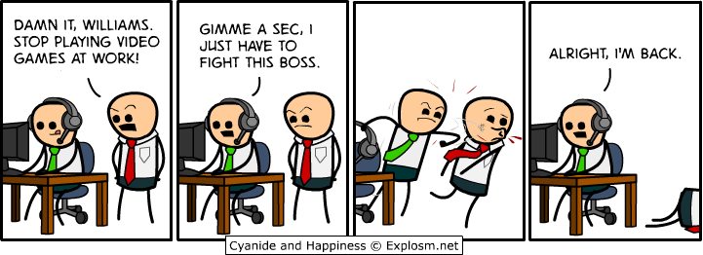
What does an effective (healthy) relationship look like?
Guidance/visioning
Pairing
Guidance on how to solve problems
Get juniors’ advice
Ensure junior understand what is going on and not just saying “I understand”
Notes:
Guidance/visioning
i. Pairing
1. Spend time with them WHILE coding.
2. In the beginning, help the junior out while on the keyboard.
3.Later, have the senior on the keyboard and the junior help think it through.
ii. Get juniors’advice
Ex: in a sprint planning meeting, ask them how they might break a task down
iii. Ensure junior understand what is going on and not just saying “I understand”
1. It’s easy to say I understand even when they don’t
2.

Slide 12
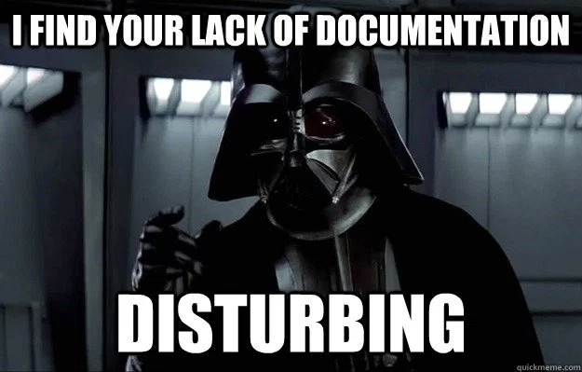
Ensuring You’re Ready for New Juniors
Do you have a senior dev that can spend time answering questions, and at least some time once a week to chat about how they’re doing?
Do you have adequate training resources? Will they be given time to learn from these?
Will they be able to grow from these experiences, even if they don’t stay at our company long? (How can they help us help them?)
The 3 P’s:
Planning
Projects
Pairing
Notes:
a. Do you have a senior dev that can spend time answering questions, and at least some time once a week to chat about how they’re doing?
b. Do you have adequate training resources? Will they be given time to learn from these?
i. Books, tutorials, documentation,
c. Will our new developer be able to grow from these experiences, even if they don’t stay at our company long? (How can they help us help them?)

Slide 13
Conclusion
Juniors and interns are GREAT people to have on teams
They come with a cost of extra time and energy from the team
They provide work, energy, enthusiasm and new ideas
They get great experience
Everyone benefits by working together to onboard and mentor the new teammate

Slide 14
Conclusion
Sarah Withee
@geekygirlsarah on Twitter
sarah@sarahwithee.com
I love feedback and hearing stories if this was helpful. Please share your company’s onboarding experiences!
Please ask any questions you may have too!

